Slide 1

HEALTH CARE
DIALYSIS DASHBOARD
- REDDY ESWAR THAI BABU

Slide 2

Introduction
Welcome to the Optimizing Dialysis Care presentation. This dashboard provides a comprehensive view of healthcare analytics for dialysis patients. Our goal is to enhance patient outcomes and resource utilization through data-driven insights

Slide 3
01
02
03
K P I ‘ S
DASHBOARDS
CONCLUSION
KPI”S ARE THE KEY PERFORMANCE INDICATORS WHICH WAS GIVEN IS EXPLAIN IN NEXT 6 PAGES
AS PER MY INSIGHTS EXCEL,TABLEAU,POWERBI
DASHBOARDS HAVE BEEN CREATED
THERE IS A CONCLUSION WHICH CAN USE FOR THIS PROJECT

Slide 4
COMING TO KEY PERFORMANCE INDICATORS

Slide 5
Number of Patients across various summaries
Gain a deeper understanding of patient distribution across different categories
ACCORDING TO INSIGHTS:
Highest number of patients are in survival summary
Least number of patients are in nPCR summary

Slide 6
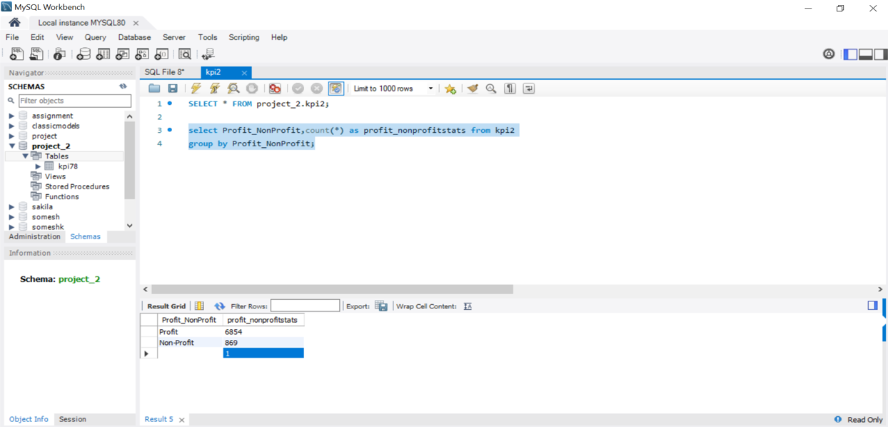
Profit vs. Non-Profit Stats
Examine the financial aspects and compare performance between profit and non-profit entities
Count of profit is 6854 which is 88.75%
Count of non profit is 869 which is 11.25%

Slide 7
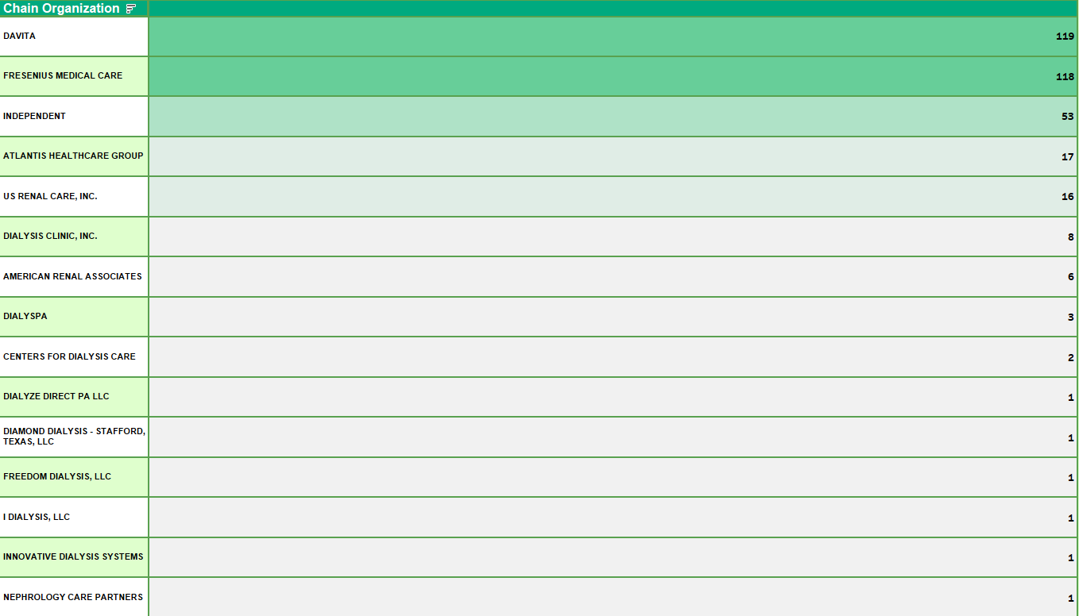
Chain Organizations w.r.t. Total Performance Score as No Score
Assess the performance of chain organizations in relation to their total performance score
Most numbers of no score performance are in ‘Fresenius medical care’ and ‘ Davita’ chain organization.
Total count of no score is 369.

Slide 8

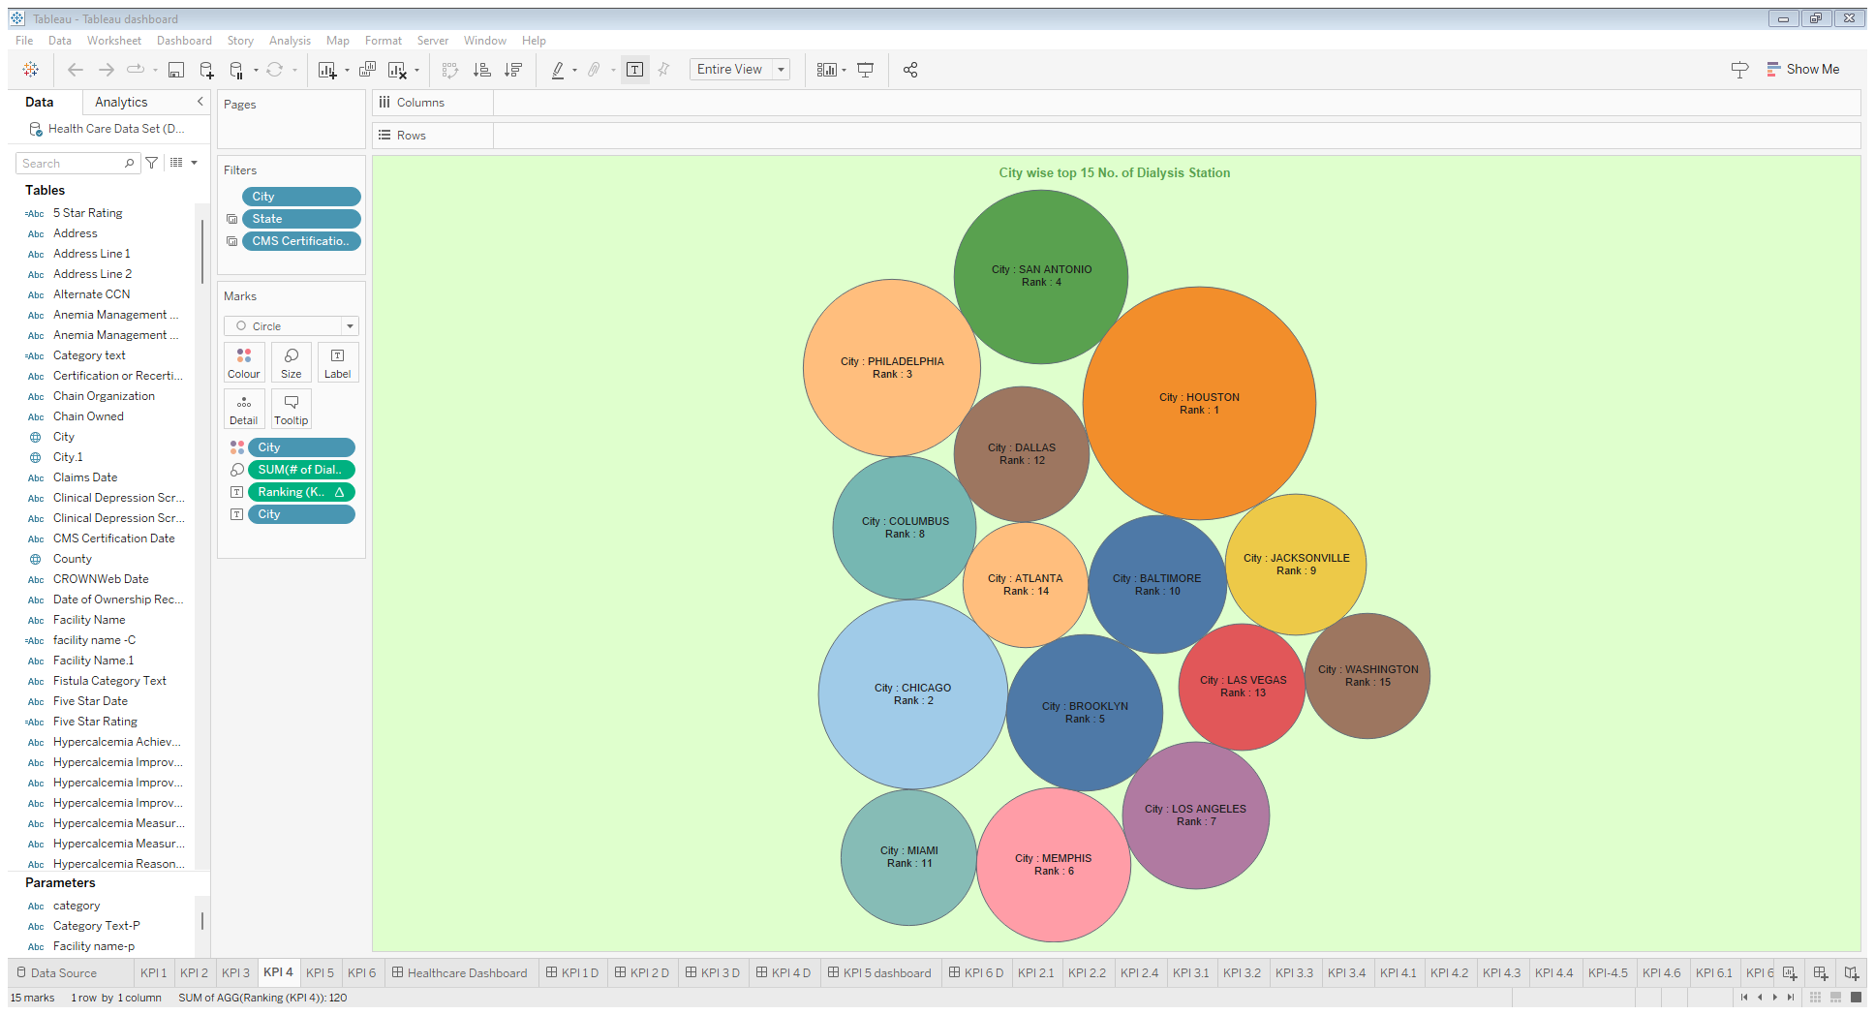
Dialysis Stations Stats:
Analyze and visualize key metrics related to dialysis stations to identify trends and patterns
Total number of dialysis station is 55328
HOUSTON city has highest number of dialysis station nearly 1911 stations

Slide 9
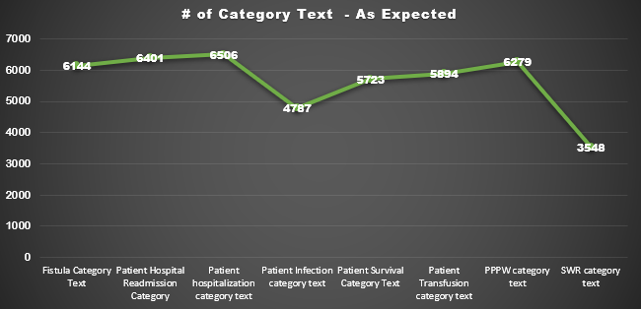
# of Category Text - As Expected:
Determine the expected number of category texts and evaluate their impact on the overall dataset
Patient hospitalization category text has the most ASEXPECTED THAN OTHER NEARLY 6506 AS EXPECTED

Slide 10
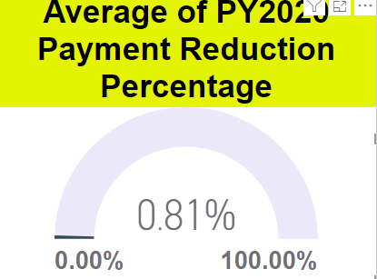
Average Payment Reduction Rate:
Calculate and track the average rate at which payments are reduced, providing insights into cost-saving measures
We had calculated the average payment reduction rate in percentage

Slide 11
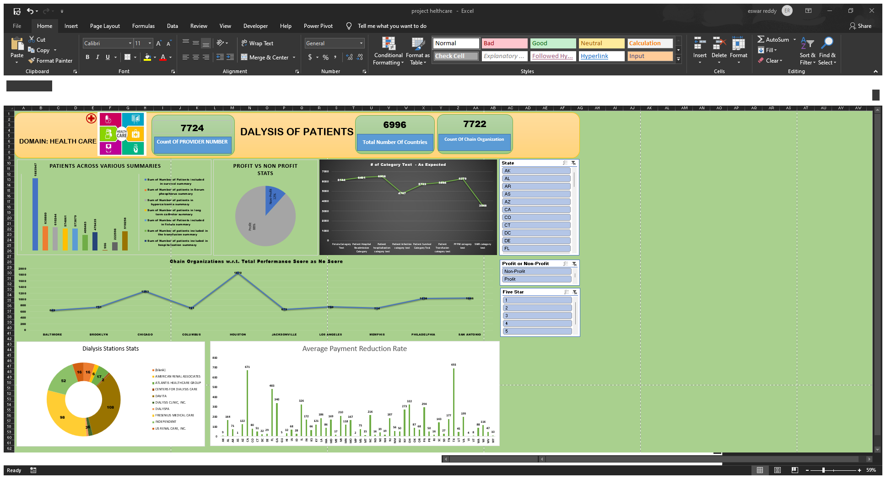

Slide 12
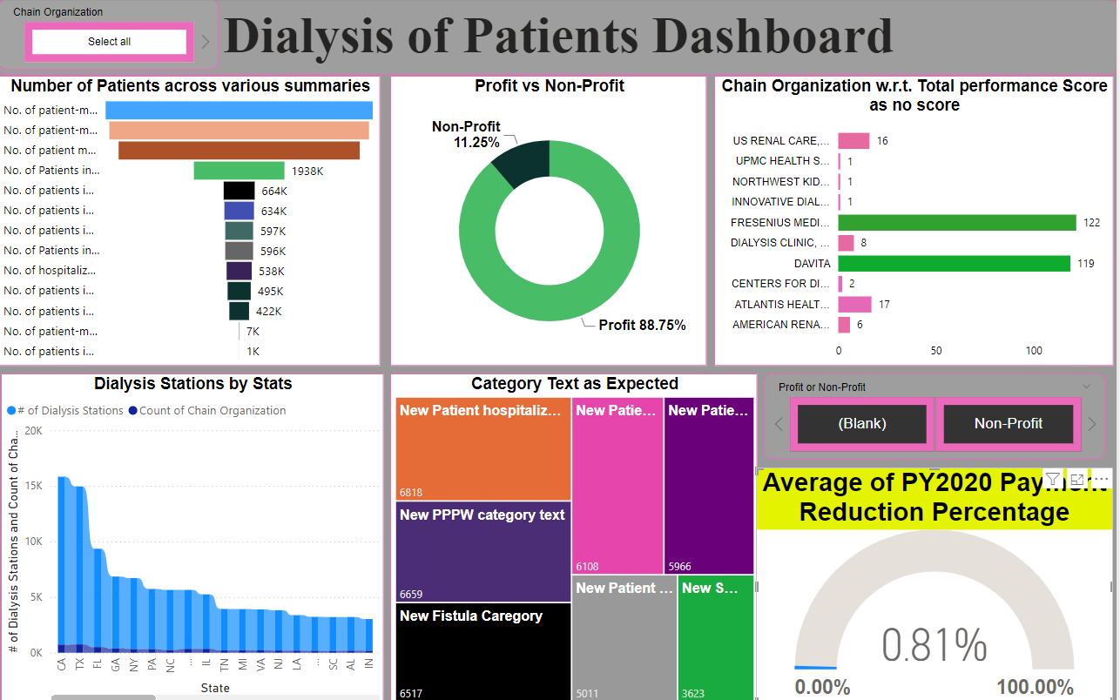

Slide 13
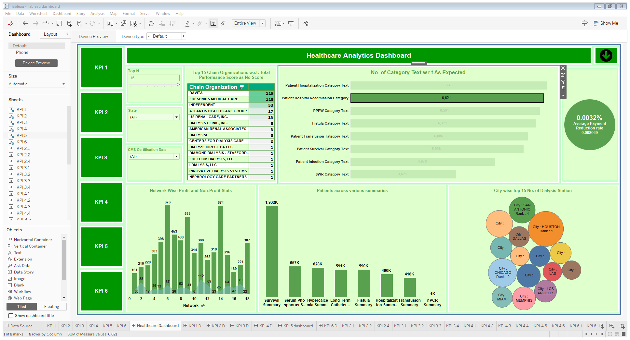

Slide 14
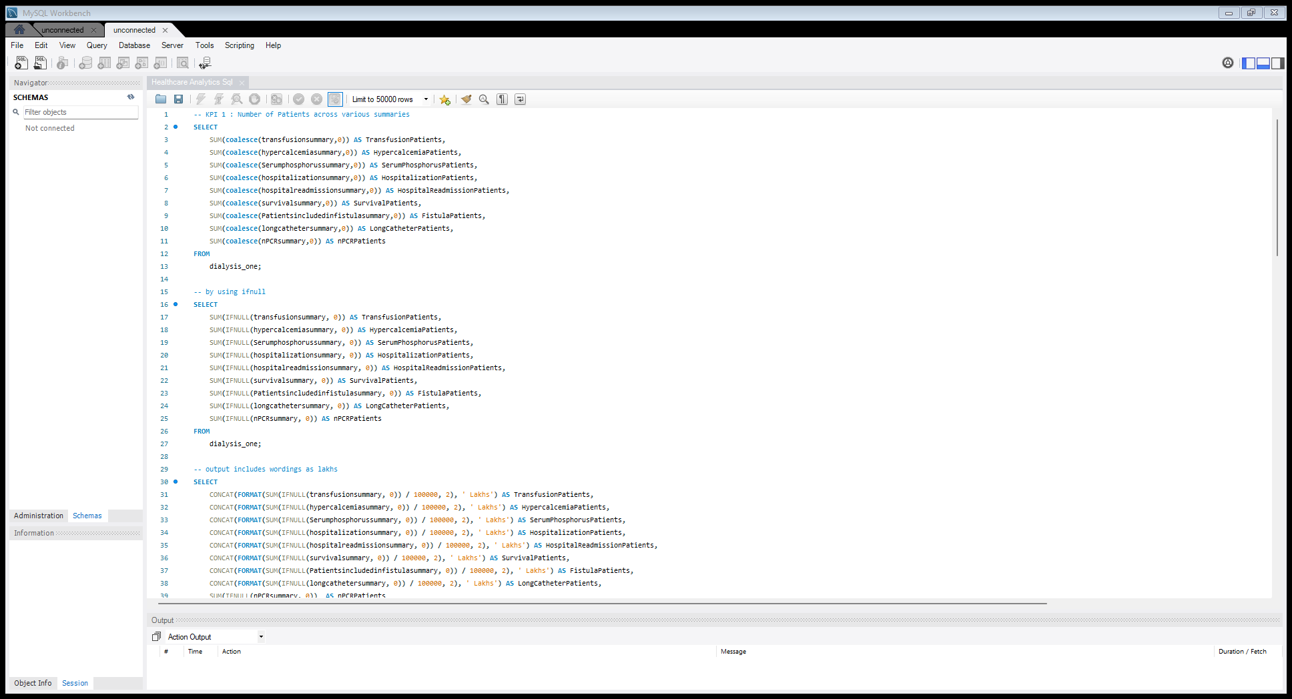

Slide 15
EXHORTATIONS:
Focus on services for survival summary, Which has highest number of patients in this category.
Try to improve more than previous profit-generating aspects, as they constitute the majority (88.75%) of patients.
Try to resolve and investigate the issues in ‘Fresenius medical care’ and ‘Davita’ chain organizations.
Regularly monitor and manage the average payment reduction rate to ensure financial sustainability.
THINGS THAT NEED TO BE DEVELOPED IN THIS PROJECT THIS MEANS SUGGESTIONS .

Slide 16
CONCLUSION :
By addressing these key issues, we can significantly improve the efficiency and effectiveness of dialysis care. Our Dialysis Dashboard provides the insights needed to make data-driven decisions that enhance patient outcomes, optimize resource utilization, and ensure financial sustainability. Key Actions: 1.Focus on high-impact areas like the survival summary. 2.Ensure accurate and comprehensive data reporting. 3.Standardize best practices across all facilities. 4.Enhance the efficiency of non-profit organizations. 5.Improve resource distribution and facility expansion. 6.Implement and monitor cost-saving measures. By taking these actions, we can create a more equitable, efficient, and effective dialysis care system that meets the needs of all patients.

Slide 17
THANKS!
REDDY ESWAR THAI BABU
HELTHCARE DIALYSIS PROJECT

